Slide 1
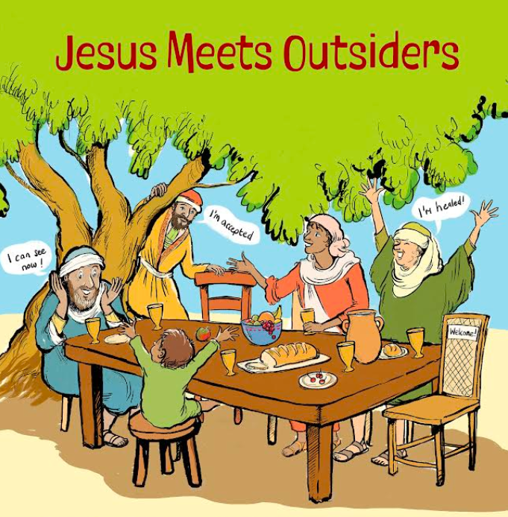

Slide 2
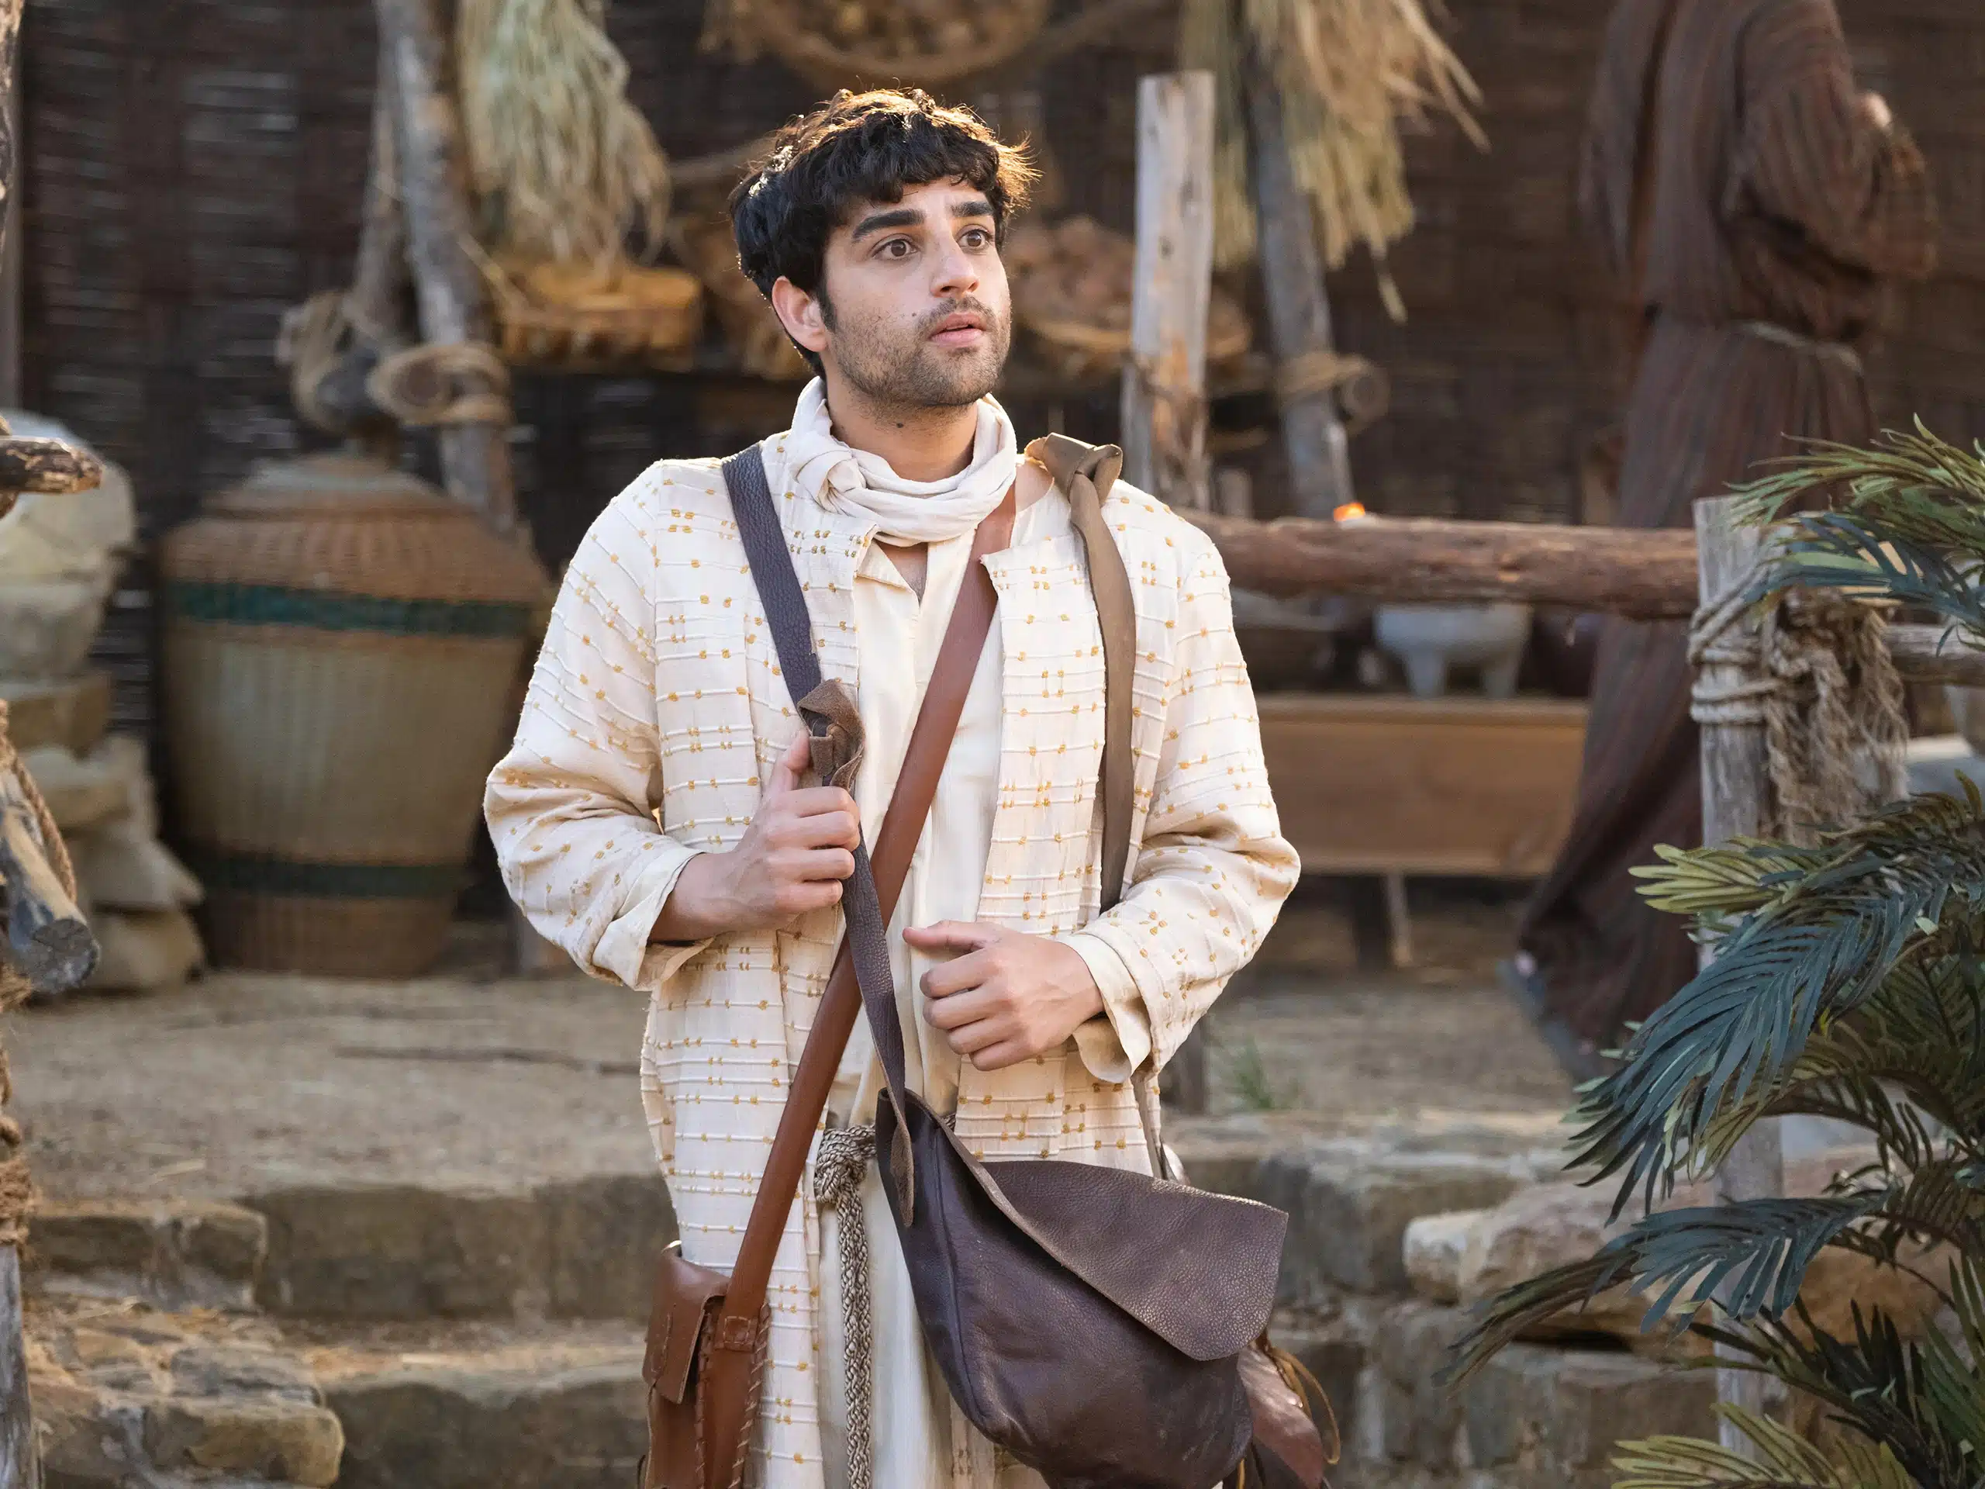

Slide 3
A Tale of Two Tax Collectors
The characters and situation
Levi | Zacchaeus
A tax collector named Levi | A man named Zacchaeus. He was a chief tax collector and was rich.
… sitting at a tax booth | He was seeking to see who Jesus was, but because of the crowd he could not, because he was small in stature. So he ran ahead and climbed up into a sycamore tree to see him
Levi
Zacchaeus
A man named Zacchaeus. He was a chief tax
A tax collector named Levi
collector and was rich.
He was
seeking
to see who Jesus was, but
because of the crowd he could not, because
…
sitting
at
a tax booth
he was small in stature.
So
he ran ahead and
climbed up into a sycamore tree
to see him

Slide 4
A Tale of Two Tax Collectors
The action
 | Levi | Zacchaeus
1 | Jesus went out and saw ... | Jesus looked up … | Jesus sees
2 | He said to him ‘Follow me’ | ‘Hurry and come down …’ | Jesus invites
3 | He rose and followed him | He hurried & came down | They respond
 | Leaving everything … | Half that I have … | The cost
4 | Levi held a great banquet | He received him joyfully | They party
5 | The Pharisees … grumbled | They all grumbled | Some grumble
6 | I have not come to call the righteous but sinners to repentance | The Son of Man came to seek and to save the lost | Jesus’ purpose

