Slide 1

The Faith of the Centurian
LUKE 7: 1-10
“I tell you, I have not found such great faith even in Israel.” Luke 7:9

Slide 2
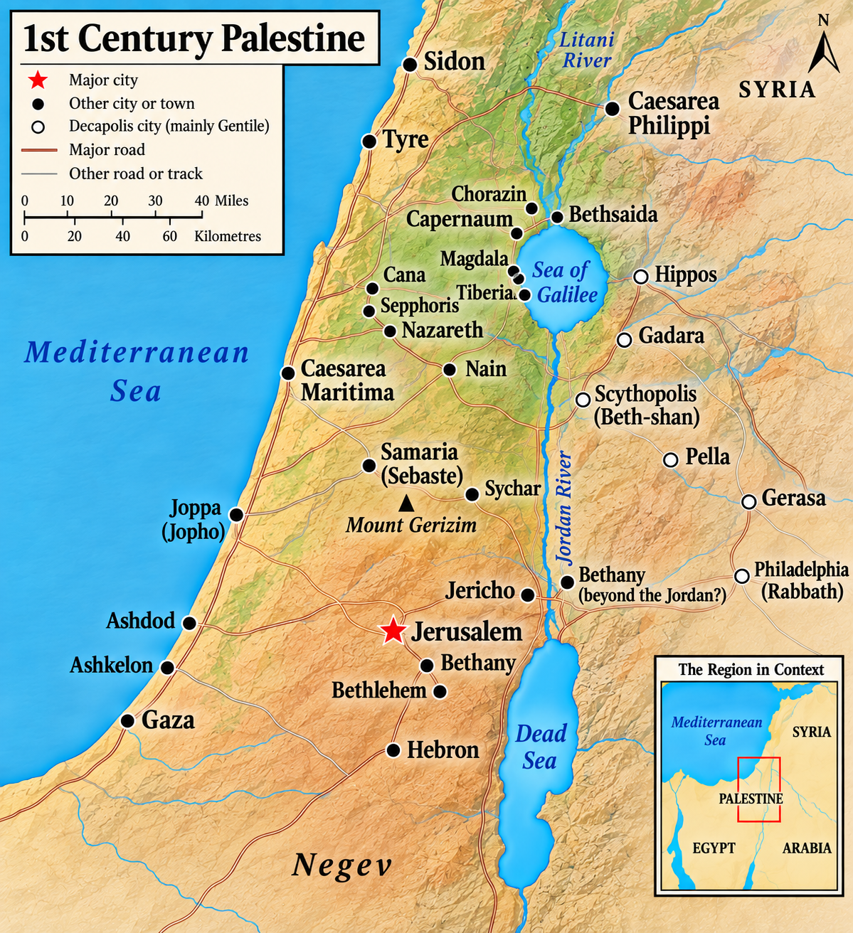

Slide 3
Therefore once more I will astound these people
with wonder upon wonder;
the wisdom of the wise will perish,
the intelligence of the intelligent will vanish.’
Isaiah 29:14

Slide 4
For I myself am a man under authority, with soldiers under me. I tell this one, ‘Go,’ and he goes; and that one, ‘Come,’ and he comes. I say to my servant, ‘Do this,’ and he does it.”
Luke 7:8

Slide 5
“All things have been committed to me by my father.” Luke 10:22

Slide 6
All authority in heaven and on earth has been given to me
Matthew 28:18:

Slide 7
If you declare with your mouth, “Jesus is Lord,” and believe in your heart that God raised him from the dead, you will be saved.

Slide 8
For I myself am a man under authority, with soldiers under me. I tell this one, ‘Go,’ and he goes; and that one, ‘Come,’ and he comes. I say to my servant, ‘Do this,’ and he does it.”
Luke 7:8

Slide 9
And now, Israel, what does the Lord your God ask of you but to fear the Lord your God, to walk in obedience to him, to love him, to serve the Lord your God with all your heart and with all your soul, and to observe the Lord’s commands and decrees that I am giving you today for your own good?
Deuteronomy 10:12-13

Slide 10

“Cheap grace is the preaching of forgiveness without requiring repentance, baptism without church discipline, Communion without confession, absolution without personal confession. Cheap grace is grace without discipleship, grace without the cross, Christ, living and incarnate.”

Slide 11
go and make disciples of all nations, baptizing them in the name of the Father and of the Son and of the Holy Spirit, and teaching them to obey everything I have commanded you. And surely I am with you always, to the very end of the age.”
Matthew 28:19-20

Slide 12
Having received the teaching of Christ, what are we going to do with it?

