Slide 1
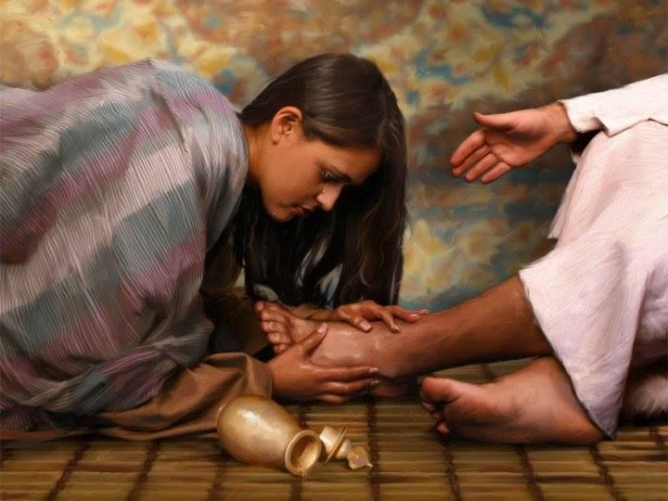
‘Sinful’ women

Slide 2
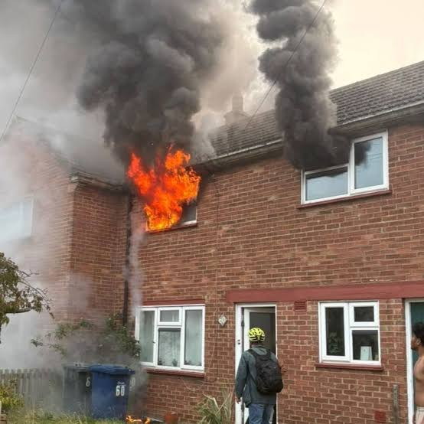
What would you rescue?

Slide 3
Luke ch 7 vss 36-50

Slide 4
²⁹ (All the people, even the tax collectors, when they heard Jesus’ words, acknowledged that God’s way was right, because they had been baptized by John. ³⁰ But the Pharisees and the experts in the law rejected God’s purpose for themselves, because they had not been baptized by John.)…
³³ For John the Baptist came neither eating bread nor drinking wine, and you say, ‘He has a demon.’ ³⁴ The Son of Man came eating and drinking, and you say, ‘Here is a glutton and a drunkard, a friend of tax collectors and sinners.’

Slide 5
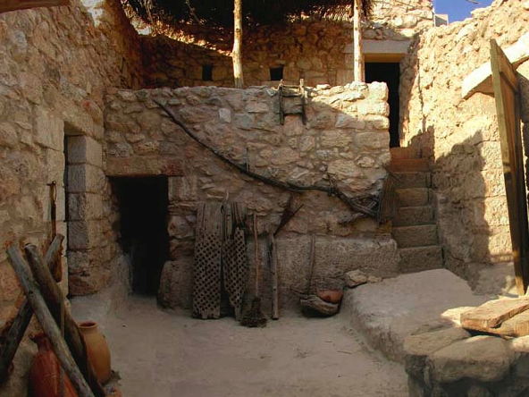

Slide 6
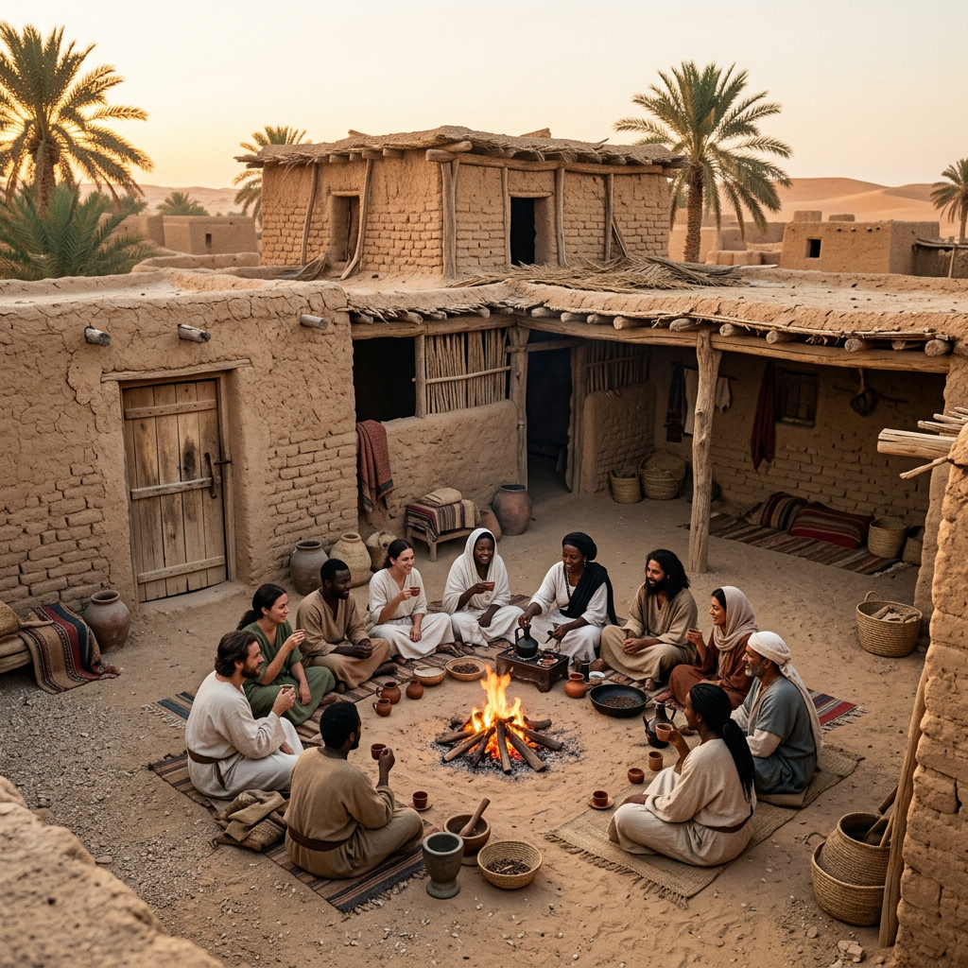

Slide 7
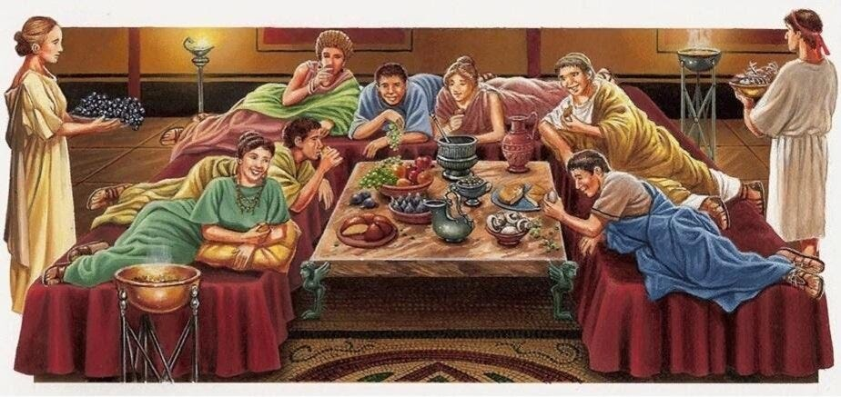

Slide 8
³⁶ When one of the Pharisees invited Jesus to have dinner with him, he went to the Pharisee’s house and reclined at the table. ³⁷ A woman in that town who lived a sinful life learned that Jesus was eating at the Pharisee’s house, so she came there with an alabaster jar of perfume.

Slide 9
³⁸ As she stood behind him at his feet weeping, she began to wet his feet with her tears. Then she wiped them with her hair, kissed them and poured perfume on them.

Slide 10
…in Rome “men no more hesitated to use slaves and prostitutes to relieve themselves of their sexual needs than they did to use the side of the road as a toilet.”
Tom Holland, ‘Dominion’

Slide 11
“Jesus’ teaching introduced two tectonic shifts. First, he loved and valued women - including prostitutes. Second, against the norms of the empire, he upheld faithful marriage as the only context for sex.”
Rebecca McLaughlin, ‘Jesus through the eyes of women’

Slide 12
³⁹ When the Pharisee who had invited him saw this, he said to himself, “If this man were a prophet, he would know who is touching him and what kind of woman she is - that she is a sinner.”

Slide 13
⁴⁰ Jesus answered him, “Simon, I have something to tell you.”
“Tell me, teacher,” he said.

Slide 14
⁴¹ “Two people owed money to a certain moneylender. One owed him five hundred denarii, and the other fifty. ⁴² Neither of them had the money to pay him back, so he forgave the debts of both. Now which of them will love him more?”

Slide 15
⁴³ Simon replied, “I suppose the one who had the bigger debt forgiven.”
“You have judged correctly,” Jesus said.
⁴⁴ Then he turned toward the woman and said to Simon,
“Do you see
this woman?”

Slide 16
Simon | The woman
did not give me any water for my feet | wet my feet with her tears and wiped them with her hair
did not give me a kiss | from the time I entered, has not stopped kissing my feet
did not put oil on my head | has poured perfume on my feet

Slide 17
⁴⁷ Therefore, I tell you, her many sins have been forgiven - as her great love has shown. But whoever has been forgiven little loves little.”
⁴¹ “Two people owed money to a certain moneylender. One owed him five hundred denarii, and the other fifty. ⁴² Neither of them had the money to pay him back, so he forgave the debts of both. Now which of them will love him more?”

Slide 18
⁴⁷ Therefore, I tell you, her many sins have been forgiven - as her great love has shown. But whoever has been forgiven little loves little.”
⁴⁸ Then Jesus said to her, “Your sins are forgiven.”
⁴⁹ The other guests began to say among themselves, “Who is this who even forgives sins?”
⁵⁰ Jesus said to the woman, “Your faith has saved you; go in peace.”

Slide 19
John ch 12 vss 1-11

Slide 20
Luke 7 woman | John 12, Mary
Happens early in Jesus’ ministry | Happens shortly before Jesus’ arrest
Woman has a reputation as a ‘sinner’ | Mary is one of Jesus’ closest friends and a disciple

Slide 21
Luke 7 woman | John 12, Mary
Both events take place in a home over a meal
Both women anoint Jesus’ feet with expensive perfume
Both women are criticised by others
Jesus defends both women

Slide 22
Luke 7 woman | John 12, Mary
Happens early in Jesus’ ministry | Happens shortly before Jesus’ arrest
Woman has a reputation as a ‘sinner’ | Mary is one of Jesus’ closest friends and a disciple
Worships because she has been forgiven | Worships out of awe and thanksgiving

Slide 23
Luke 7 woman | John 12, Mary
Happens early in Jesus’ ministry | Happens shortly before Jesus’ arrest
Woman has a reputation as a ‘sinner’ | Mary is one of Jesus’ closest friends and a disciple
Worships because she has been forgiven | Worships out of awe and thanksgiving… and to prepare Jesus for burial

